Slide 1
Auckland city books website
Brief introduction and technical implementation
Jianyang zhang #1477617
2/11/2016

Slide 2

introduction

Slide 3
Purpose and client
Auckland City Books website is an online book store for Auckland City Books company
It represents the products and information of the company to customers
Customers select and purchase these products online
Target clients are mainly customers of Auckland City Books, who have to or would like to get the information and book or purchase products from Internet.
Another type of clients are business partners

Slide 4
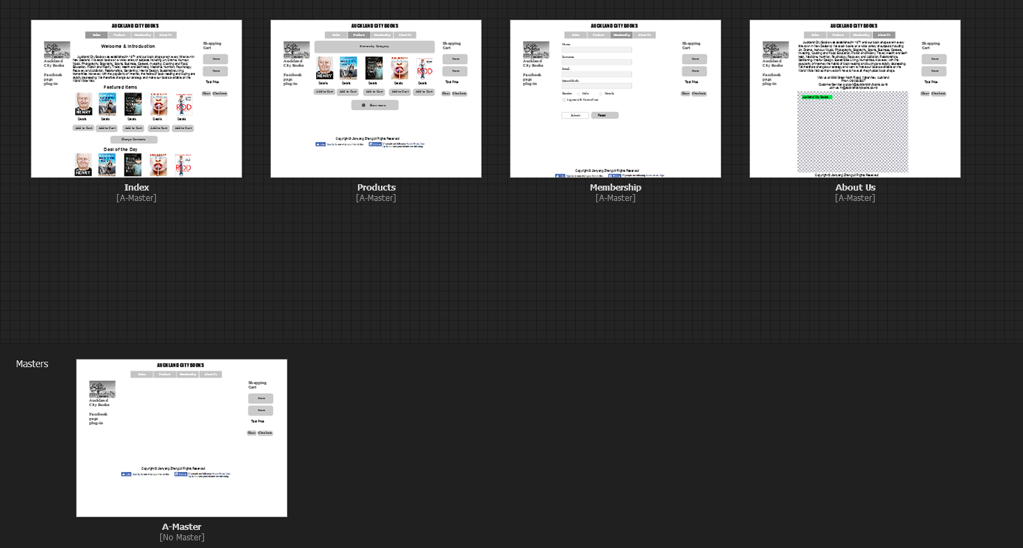
design features
Master page
Index
Products
Membership Signup
About us

Slide 5
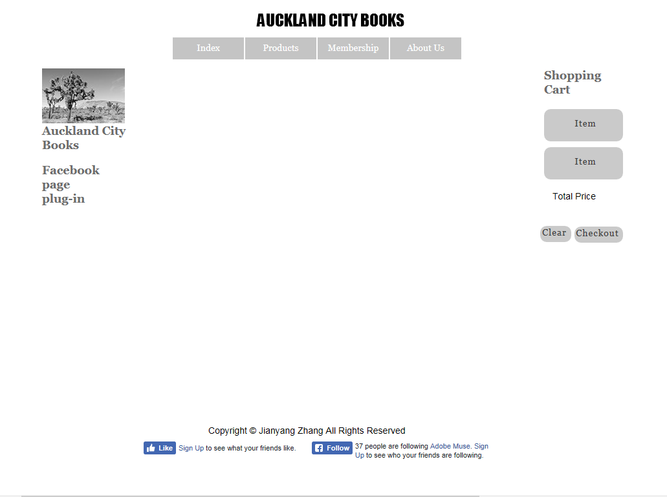
Header
Navigation Bar
Facebook
Page
Plug-in
Shopping
Cart
Fixed Footer

Slide 6
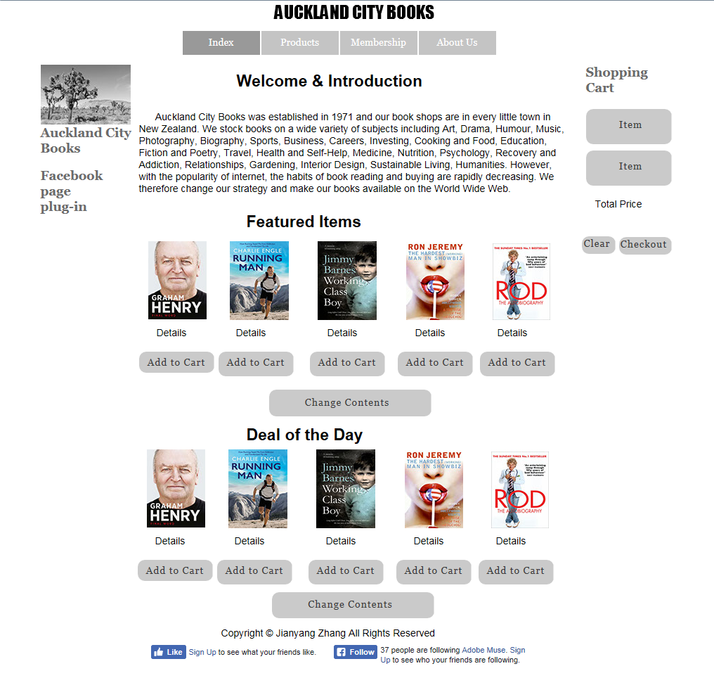
Introduction
Featured Items
Deal of the Day

Slide 7
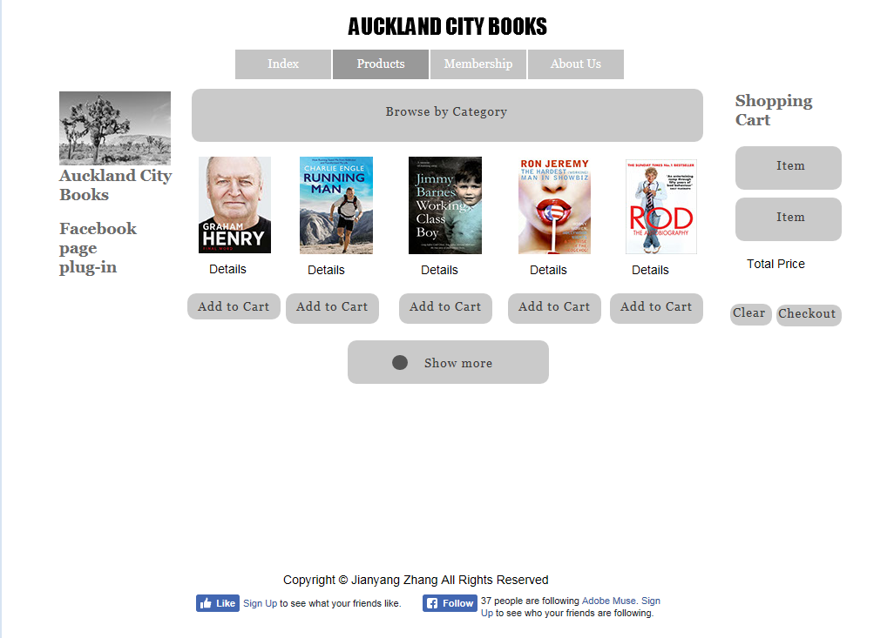
Products

Slide 8
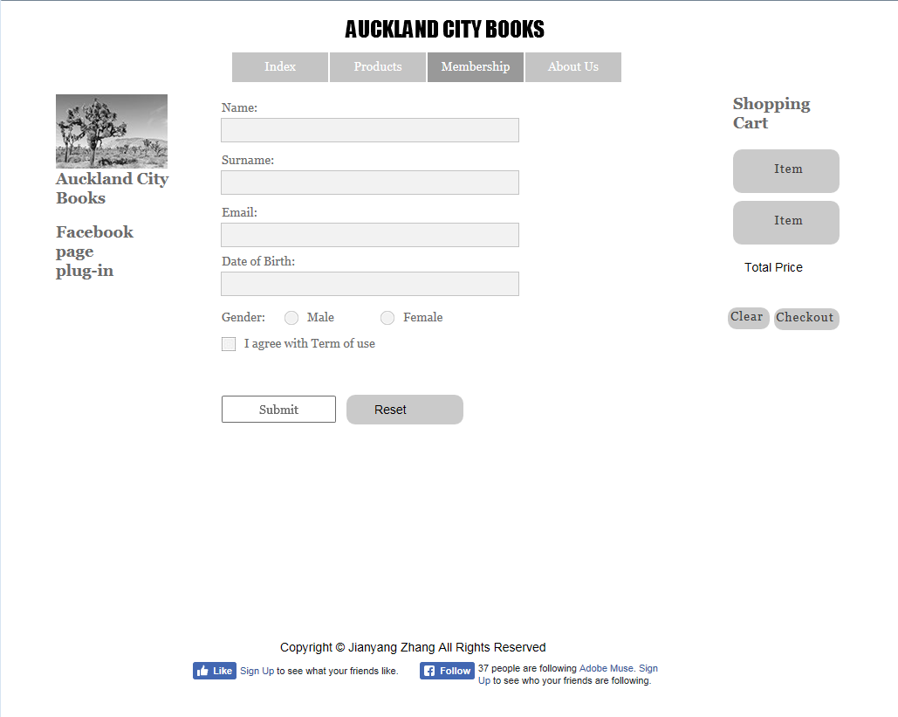
Submission Form

Slide 9
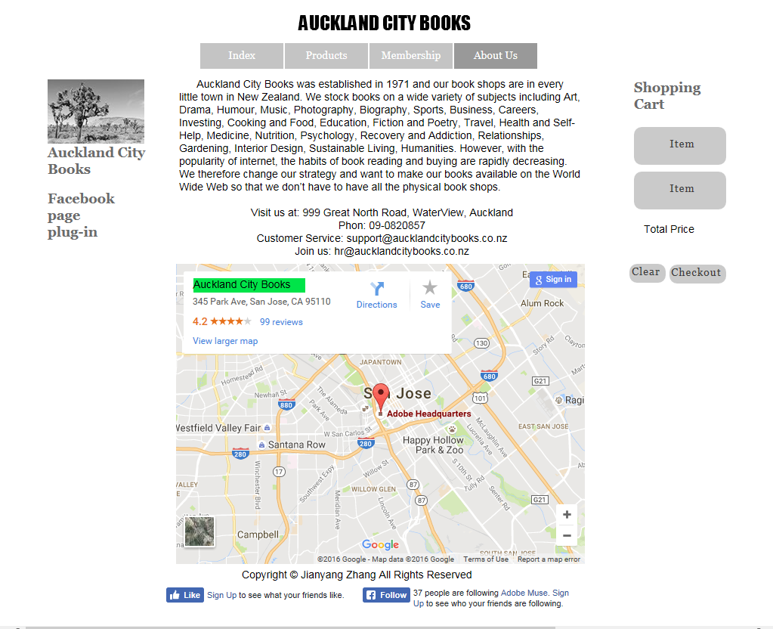
Information
Contact Details
Google Map

Slide 10
Technical features
Layout
Bootstrap
CSS flex box
CSS inline block
AJAX
JSON file
jQuery AJAX
getJSON
post

Slide 11
Technical features
Main objects
Book
BookShelf
Item
ShoppingCart
store

Slide 12


Book & bookshelf
Book
Attributes
nodeElement
BookShelf
Push
nodeElement

Slide 13
Item & shoppingcart
Item
Book object
Unit price
Quantity(add, reduce)
nodeElement
ShoppingCart
Item list
nodeElement
popBook, pushBook
Calculate total price
Clear

Slide 14
Advantages of OOP
Writing the library is time consuming, but implementation of each page is very fast
Load the correct data from server for each page
Extremely efficient for large project that has many pages
Easier to maintain and read

Slide 15
interaction
None – I am the only group member

Slide 16
challenges
Implement the bookstore using OOP
Persist shopping cart: demo
Dynamic bookshelf layout

Slide 17
Future improvements
Need more test on IE
Expand products and categories range – JSON to database; more back end technologies
Auckland City Books

